Slide 1
Applying Visual Design Best Practices in Power BI
Michael Hewitt
SQL Saturday Nashville
January 18, 2020

Slide 2
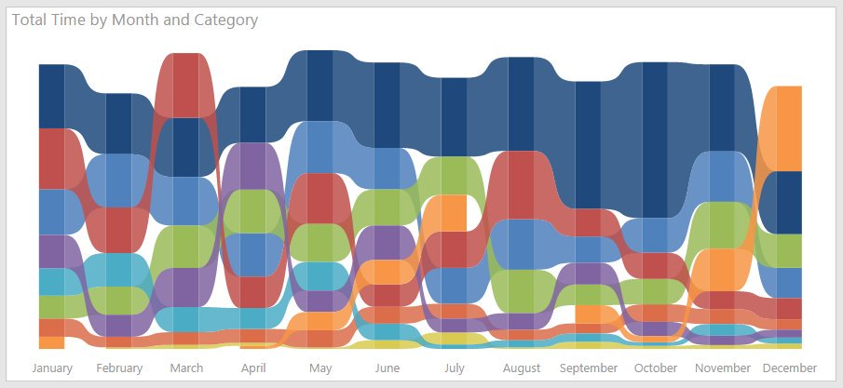
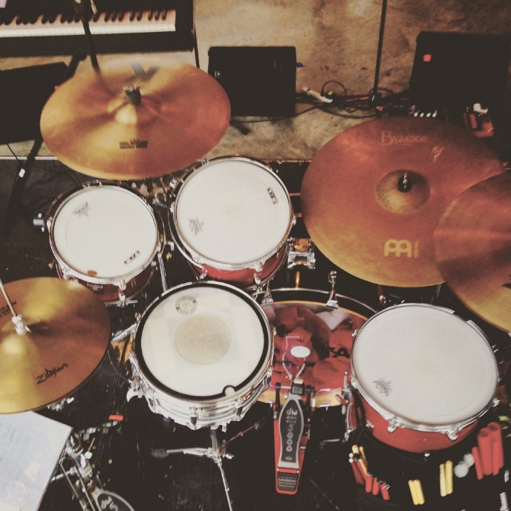
Michael Hewitt
Business Intelligence Developer
@mdhewitt83
mdhewitt83
www.linkedin.com/in/mdhewitt83/

Slide 3
Notes:
How many Power BI users? Other visualization tools?
Analysts? Developers? DBAs? Report writers?

Slide 4
AGENDA
Report Design and Layout
Designing and Visualizing for Different Audiences
Creating and Implementing Custom Report Themes
Notes:
There are many best practices in report design, these 3 offer a good starting point to springboard off of

Slide 5
REQUIREMENTS
Traffic accident trend during the last decade
Top 10 accident locations
See count of accidents by lighting condition (dark, dusk, dawn, day)
Filter by Hit & Run (Y/N/Unk), Injury Accident (Y/N/Unk), Fatalities (Y/N/Unk), Weather Condition, & Number of Motor Vehicles Involved
Notes:
Gathering good requirements is necessary to a good design. Meet with key stakeholders to understand their pain points and needs for reporting. Interview SME’s to gain understanding of business processes, the data, and calculations. Create a storyboard and wireframe and present to the stakeholders prior to development.
Metro Nashville traffic accidents data from Data.Nashville.gov

Slide 6
What is the best way to present this data
so that the user can understand the story
and take action?
Notes:
There is a lot of research being done in data visualization, how do we take that great work that is being done and apply that in our organization?
As report writers/designers, often times end users are looking to us to help them find the insights in their data

Slide 7
REPORT
DESIGN
and
LAYOUT
Notes:
Photo: Henry Studley Tool Chest
Attention to detail in laying out a report well goes a long way in user experience

Slide 8
Title
Notes:
Imagine that this slide is a blank desktop or tablet report canvas
Title – Every page should have a descriptive or action title. Give users a context of the data that is on being displayed and indicate how the user should take action.

Slide 9
Title
Notes:
Move from left to right, top to bottom across the screen
The most important visuals at the top left, least important at the bottom right

Slide 10
Navigation or Filters
Title
Navigation or Filters
Navigation or Filters
Notes:
Navigation and filter elements can live at the top, left, or right side of the screen depending on your requirements or preferences.
Will the user need to make selections in a slicer to draw meaning from the visuals on the page?
Are there navigation elements, like a back button on a drill through page or buttons that control bookmarks, that are a critical part of the UX?

Slide 11
Title
Important Navigation or Filters
Notes:
Mobile Design
In a portrait layout, generally top to bottom
Power BI’s mobile reports work but the experience is a bit clunky – report design is not as flexible
The key is to keep it simple
Don’t try to force all of the content from a desktop report into a phone screen. Choose the data/visuals that are most important or that a user would need to monitor on the go and include those.
1 or 2 important filters, more than that make the report feel bulky
Use responsive mode on the visuals

Slide 12
DEMO
Notes:
Layout report using these best practices
Create mobile report to demonstrate pros & cons

Slide 13
DESIGNING
FOR
DIFFERENT
AUDIENCES
Notes:
Designing for different audiences
Conditional formatting on tables – be careful of clutter!
Add visuals along with a table to say the same thing – often the more “visual” visuals may not be the preference of your audience but have a great impact and can help to increase the visual literacy in the organization. Use bookmarks to toggle between the graph and table.
Photo by John Schnobrich

Slide 14
DEMO
Notes:
Add table and create buttons to toggle back and forth between visuals – Demonstrate “wiring up” the bookmarks

Slide 15
CUSTOM
REPORT
THEMES
Notes:
Photo by Marko Blazevic

Slide 16
DEMO
Notes:
Color.adobe.com
Power BI Desktop December 2019 release – turn on the preview feature!
https://powerbi.tips/tools/report-theme-generator-v3/

Slide 17
Notes:
Photo by Artem Maltsev

Slide 18
Michael Hewitt
mdhewitt83@gmail.com
@mdhewitt83
mdhewitt83
www.linkedin.com/in/mdhewitt83/

